Slide 1
Tokenization of Top Reddit Replies
Vincent Smith
Aryan Osqueezadeh

Slide 2

What is Reddit
Social Media Platform
Divided into communities called subreddits
Users can post in subreddits
Users can reply to posts
Posts and replies can be upvoted/downvoted
“Score” is determined by upvotes + downvotes

Slide 3
Motivation
Find if there is significant correlation between specific tokens and number of upvotes
Replies over Posts
Most posts have little to no text
Most posts focus heavily on images/videos
Studies generally look at posts more

Slide 4
Challenges
The first challenges we faced was how much data could we get using the free version of the Reddit API
The second challenge was getting the data, as we could only do one or two subreddits before getting hit with rate limits
The third and final challenge was that even after preprocessing the data, there was still a significant amount of single letter and stop word tokens that got through the initial processing

Slide 5
Reddit API
We accessed the Reddit API using PRAW, Python Reddit API Wrapper, which required the creation of an application on Reddit, but gave functions that were immediately useful to retrieve data from Reddit
https://praw.readthedocs.io/en/stable/index.html
Using PRAW, each subreddit was its own object, with child objects for posts, which then had comments as children
Using the subreddit.hot(limit=100) function, we got the top 100 posts from a subreddit, then the top 100 comments, which were then preprocessed

Slide 6
Initial Preprocessing
After retrieving the comments, they were fed into a regex expression to remove new lines, tabs, ellipses, and emojis
Each comment would be loaded, processed, then saved as a line of plain text into a txt file specific to the subreddit it came from
This was then performed for the top 25 most popular subreddits as retrieved by the PRAW reddit.subreddits.popular() function

Slide 7

Final Preprocessing
Separate each reply into tokens
Removed tokens if they were:
Hyperlink
Single letter (e.g. “I”, “a”)
Stop words
Lemmatized remaining tokens

Slide 8
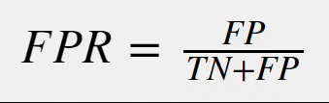
The Algorithm
Misra-Gries
Used on tokens that passed through preprocessing
Performed individually on all 25 subreddits
Performed as a whole on all subreddits combined
Calculated False-Positive Rate for each round of Misra-Gries
Kept track of most used words across all subreddits

Slide 9
Buffer Size
Ran through Misra-Gries with many buffer sizes
Ended up with three candidates:
750 - Good, but had high False-Positive Rates
1500 - Lower False-Positive Rates, but some subreddits were too small
800 - Just right

Slide 10
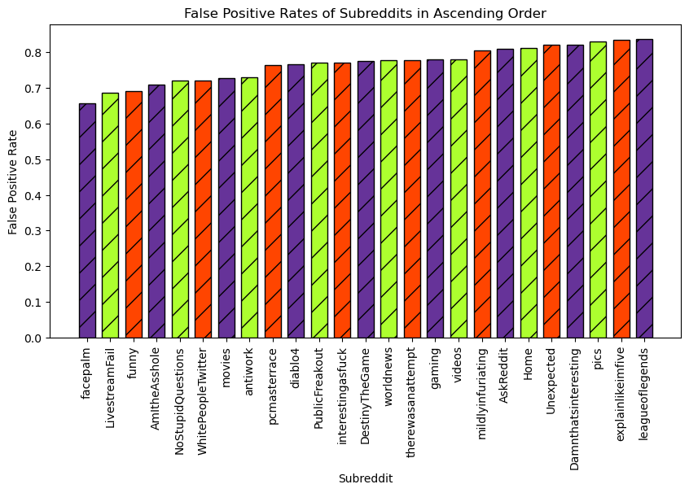
Results
False-Positive Rates
Very high
No good pattern
Not helpful

Slide 11
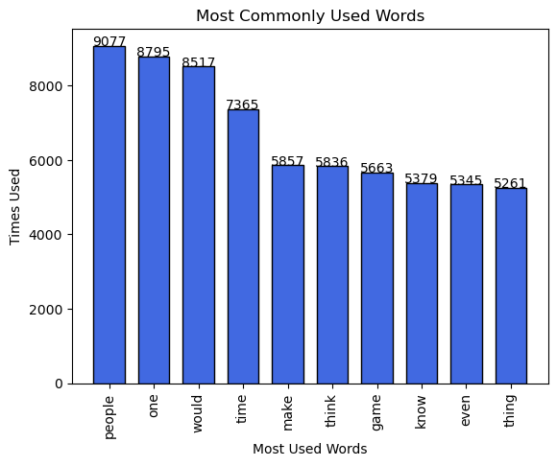
Results
10 Most Used Words
Very Common
Sudden Drop Off
Not Very Significant
Possibly Significant?
Think
Know

Slide 12
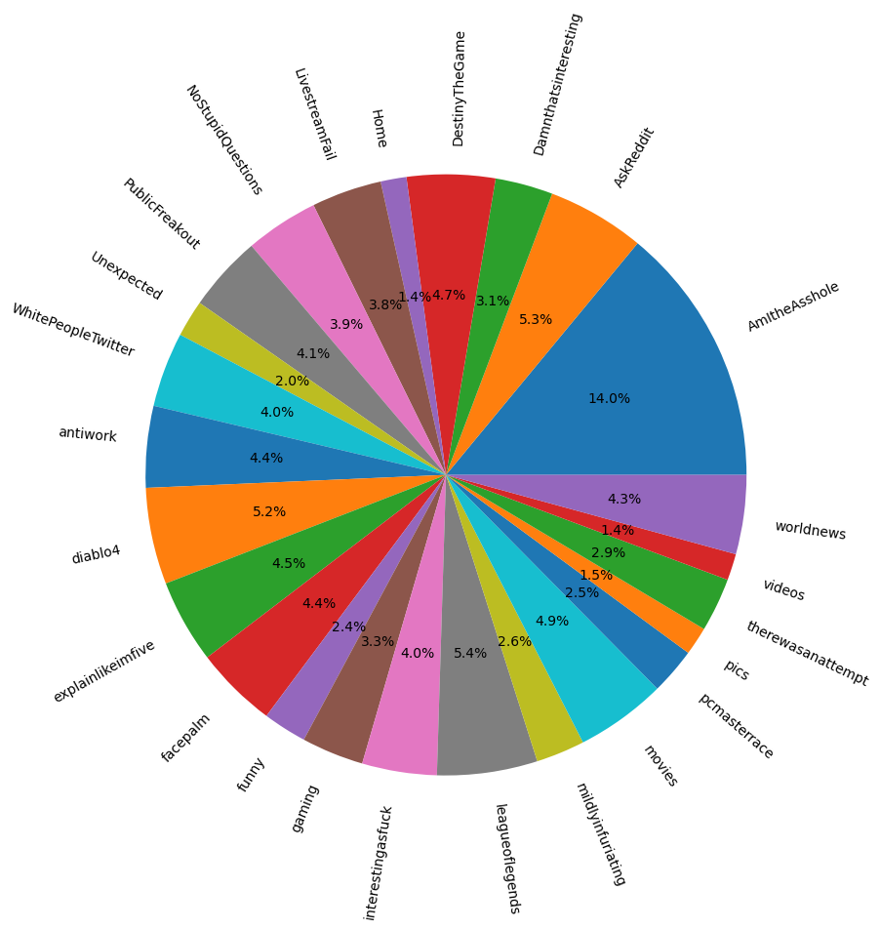
Results
Most Words Per Reply
Big Leader
Not Significant Afterwards
Top 4 Subreddits
Discussion
AmItheAsshole
AskReddit
Gaming
Leagueoflegends
diablo4

